Slide 1

Team: CDM-Mesh
Lightning Talk
Team MoorML
Lightning Talk

Slide 2
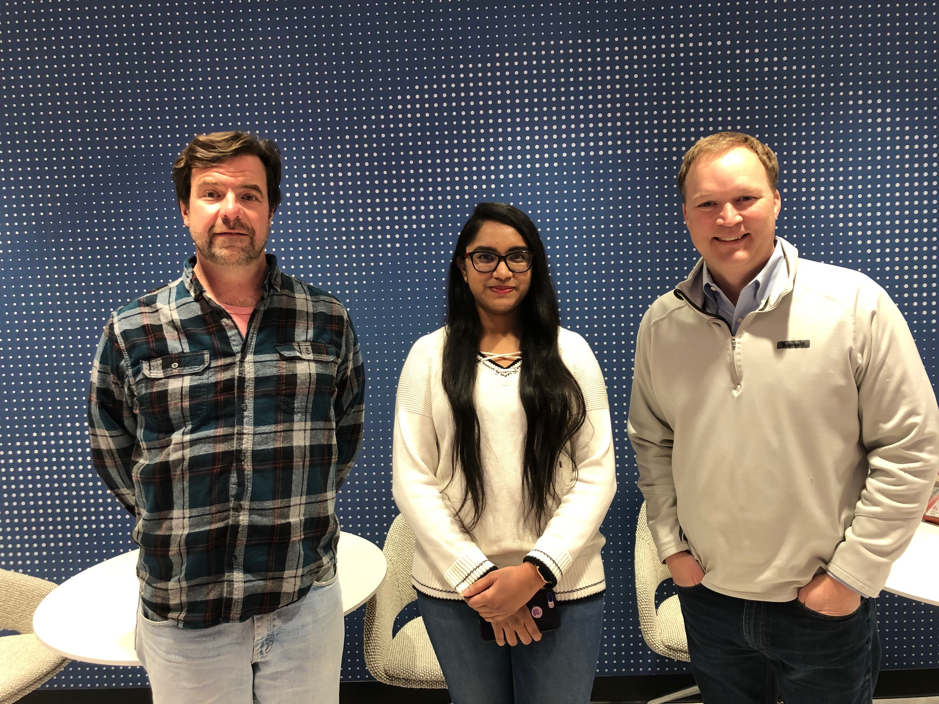
Goal:
Next Phase:
Use Oracle Analytics Cloud to build a ML model that predicts if an order will be delivered on-time or shipped late!
Improve model accuracy
Test for alternative models
Review other available methods for ML
Value:
ML can help identify late orders
This late order prediction can be associated with key customers, orders, regions and products.
Prioritizing resolution of late shipments will improve customer satisfaction and delivery times.

Slide 3




Analytics Architecture
Oracle Cloud Infrastructure Data Center Region (ASH)
Oracle Service Network
Analytics Cloud
ADW
Object Storage
OKTA/IDCS
Customer

Slide 4
Demonstration
Notes:
Notes for dashboard:
This view shows the impact of the ‘predicted’ late shipments. These are all orders that have not yet been shipped, but we are predicting with the model that we will not ship by the promise date.
The summary at the top shows that 719 customers overall are likely to be late. Over $5.5M in orders and 6,704 items will be late.
Top customers: this shows the customers and top amounts that are predicted to be late. NOTE that Los Angeles World Airports is 2.6M order that will be late (due in mid march)
Customer Locations: the top locations impacted by late deliveries (also showing LA as highest)
By day: The greatest impact is expected to occur in March 2020

Slide 5
Thank you

Slide 6
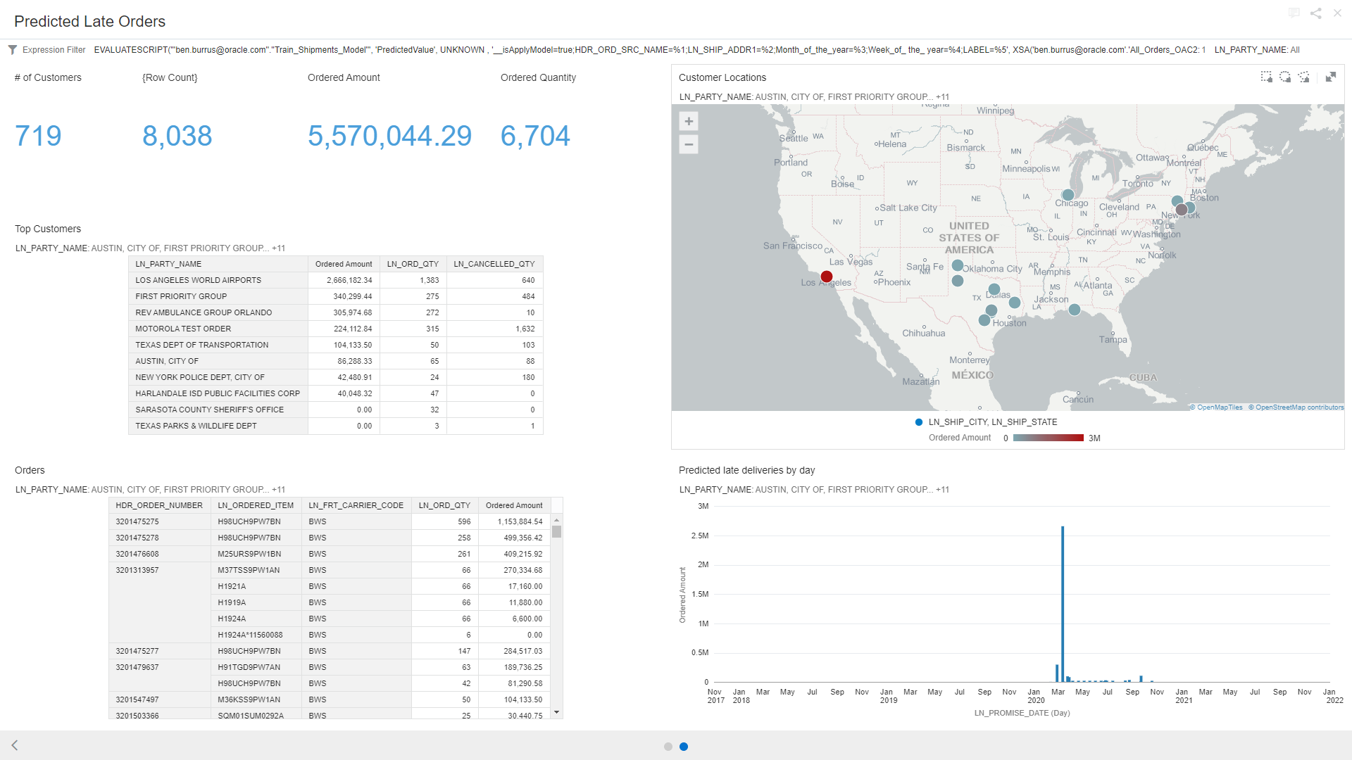
Notes:
This view shows the impact of the ‘predicted’ late shipments. These are all orders that have not yet been shipped, but we are predicting with the model that we will not ship by the promise date.
The summary at the top shows that 719 customers overall are likely to be late. Over $5.5M in orders and 6,704 items will be late.
Top customers: this shows the customers and top amounts that are predicted to be late. NOTE that Los Angeles World Airports is 2.6M order that will be late (due in mid march)
Customer Locations: the top locations impacted by late deliveries (also showing LA as highest)
By day: The greatest impact is expected to occur in March 2020

Slide 7
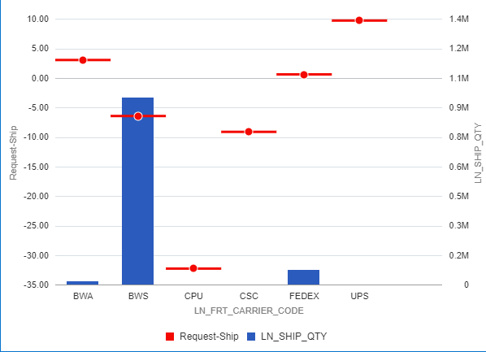
Carrier Performance
FedEx, UPS and BWA are late on average
BWS ships the most and is on time on average.

Slide 8





Oracle Cloud Infrastructure Data Center Region (ASH)
SaaS (ASH)
BICC/UCM
Internet
Gateway
Oracle Service Network (Public IP)
ERP Cloud
Analytics Cloud
ADW
Object Storage
Identity Cloud Service
OKTA/IDCS
FastConnect/VPN
Customer

